Slide 1
Design & Control of USVs for Oil-Spill Cleanup
111117019 - Athithya Kumar
111117030 - Devarasetty Sasi Preetham
111117036 - Gudapati Nitish
Guide - Dr. T. Ramesh

Slide 2
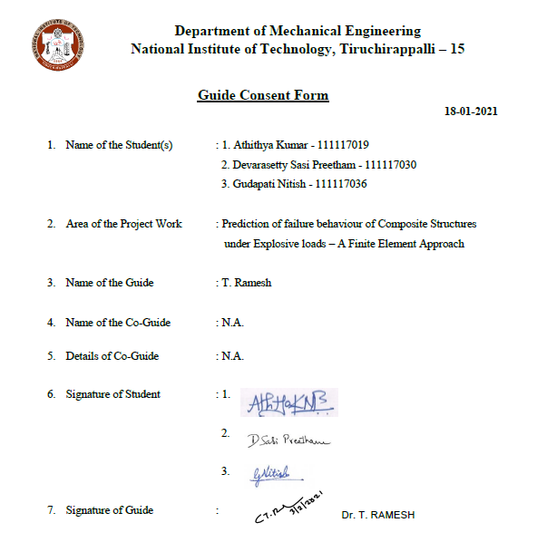
Consent Letter

Slide 3
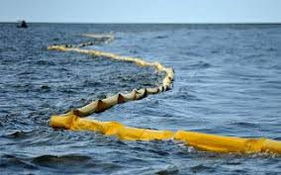
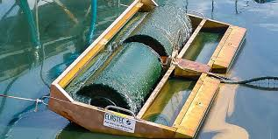
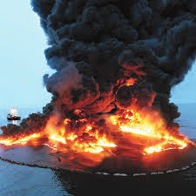
Inspiration
Commonly used methods to cleanup oil spill :
Using Oil Booms : Equipment called containment booms acts like a fence to prevent the oil from further spreading.
Using Skimmers : Skimmers are machines specially designed to suck up the oil from the water surface.
Using Sorbents and Dispersants: Sorbents are materials that soak up liquids by either absorption or adsorption.
Burning In-situ : The oil floating on the surface is ignited to burn it off.
Using Manual Labour : The method requires hand-held tools and manual labour to clean up the contaminants.
Drawbacks :
Booms are effective only within few hours of spill taking place and cannot handle fluctuating tides.
The presence of debris is a major problem for using skimmers.
Use of sorbents/dispersants can be hazardous to marine life.
Burning the oil releases toxic fumes leading to environmental damage.

Slide 4
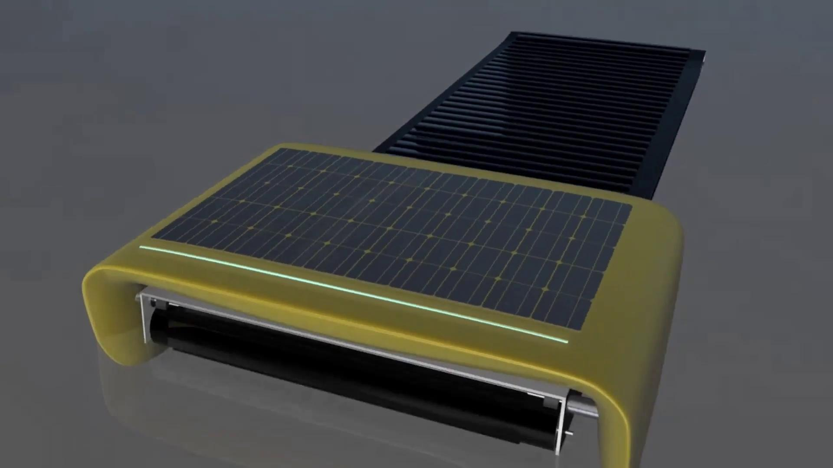
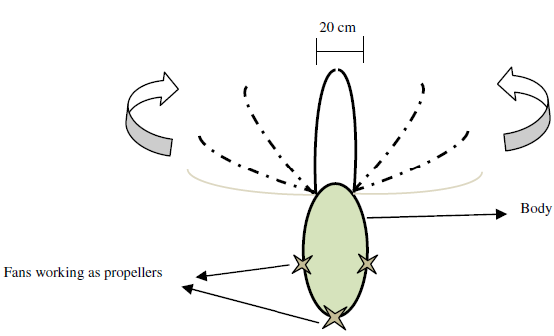
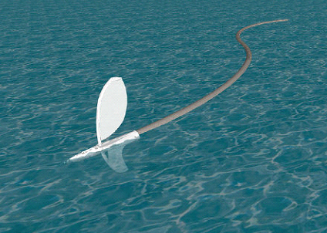
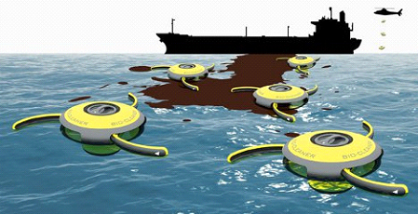
Literature
Seaswarm - MIT, Hydrophobic nano material for oil absorption, surface tension based propulsion.
E M H. Zahugi, et al. “Oil Spill Cleaning Up Using Swarm of Robots”, Advances in Computing & Inf. Technology, AISC 178, pp. 215–224.
Protei uses the wind to power an unmanned sailing drone, which pulls a long oil-absorbent tail upwind.
Roomba, The Bio-Cleaner system is just a concept at this point. Compartment full of bacteria to degrade the oil.

Slide 5
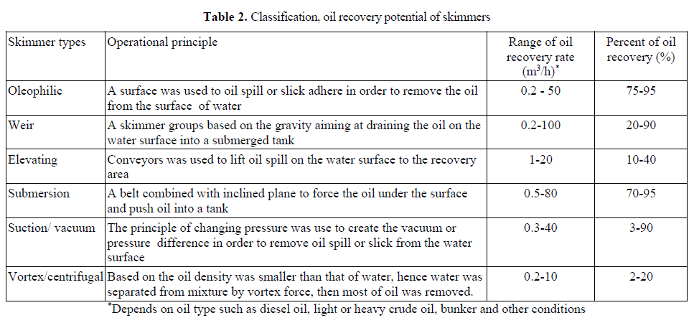
Different types of skimmers for oil recovery from water surface and their efficiency and recovery rate.
* International Journal of Applied Engineering Research, “A Report of Oil Spill Recovery Technologies” Anh Tuan Hoang, et. al. ISSN 0973-4562 Volume 13, Number 7 (2018) pp. 4915-4928

Slide 6
Objective
We propose a design of unmanned Surface vehicles to efficiently in clear up the oil spills compared to the conventional methods.
In this study, we analyse the design and control of a USV and possibly extend it further to dynamics and swarm.
Design Synopsis
Mechanism uses oleophilic skimmer (oil attracting material) like polyethylene terephthalate (PET), polypropylene, carbon-based sponges etc, to separate oil and water efficiently.
USVs can move in all directions (i.e) Mobility in all directions without direction change (3 DOF - Linear in X & Y and Rotation about Z).
Controller type : PID/LQR

Slide 7
